Slide 1
APPALACHIAN TRAIL TOWNS
Doug Labbe

Slide 2
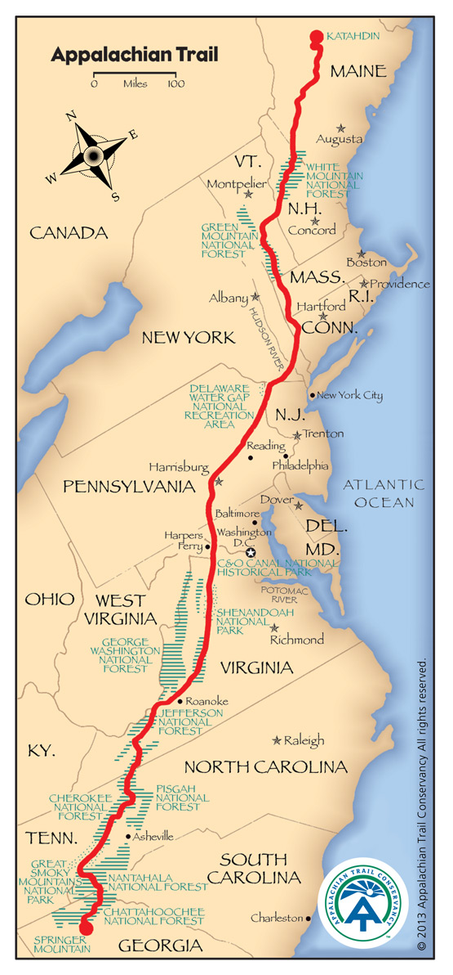


Slide 3
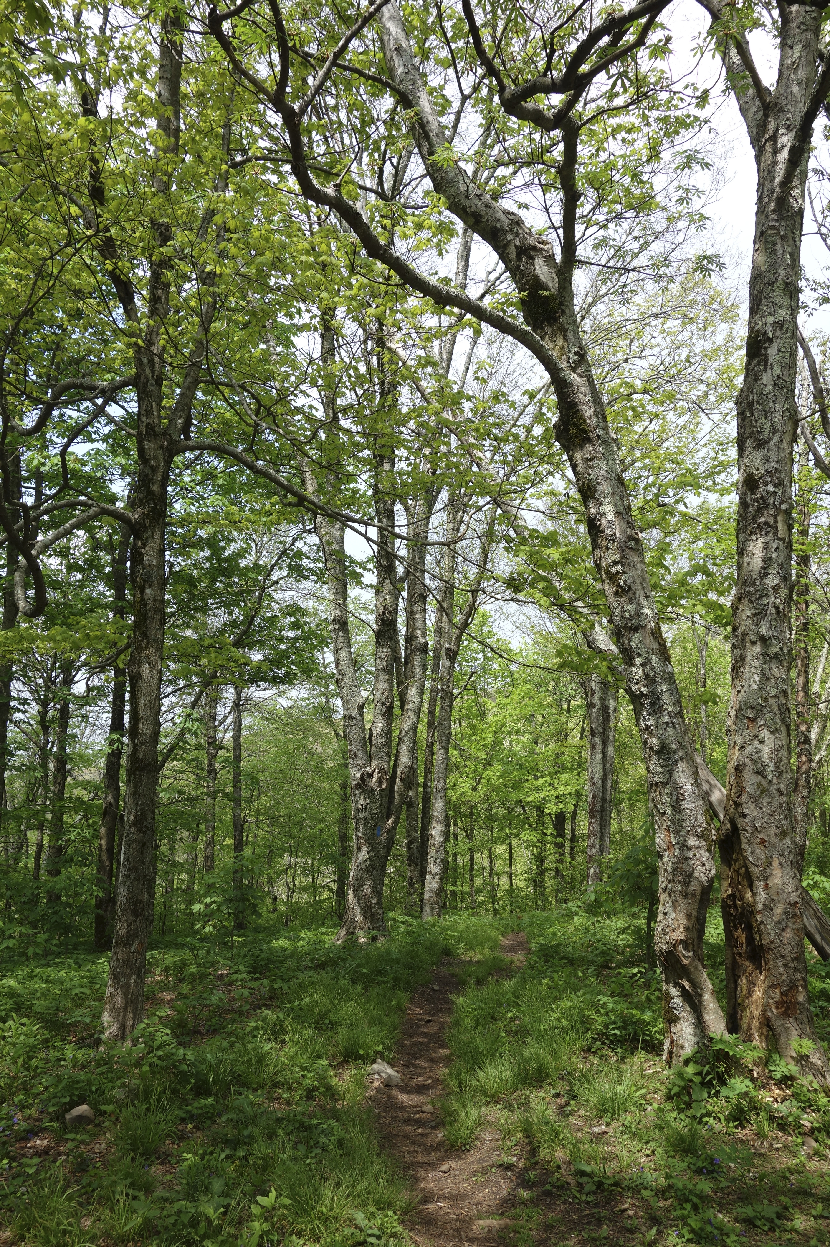
GOAL – A “Trail Towns” guide
Browse hiker-friendly services along the trail.
Provide hiker-specific details about local businesses.
Call businesses or visit their websites
Map and navigation capability

Slide 4
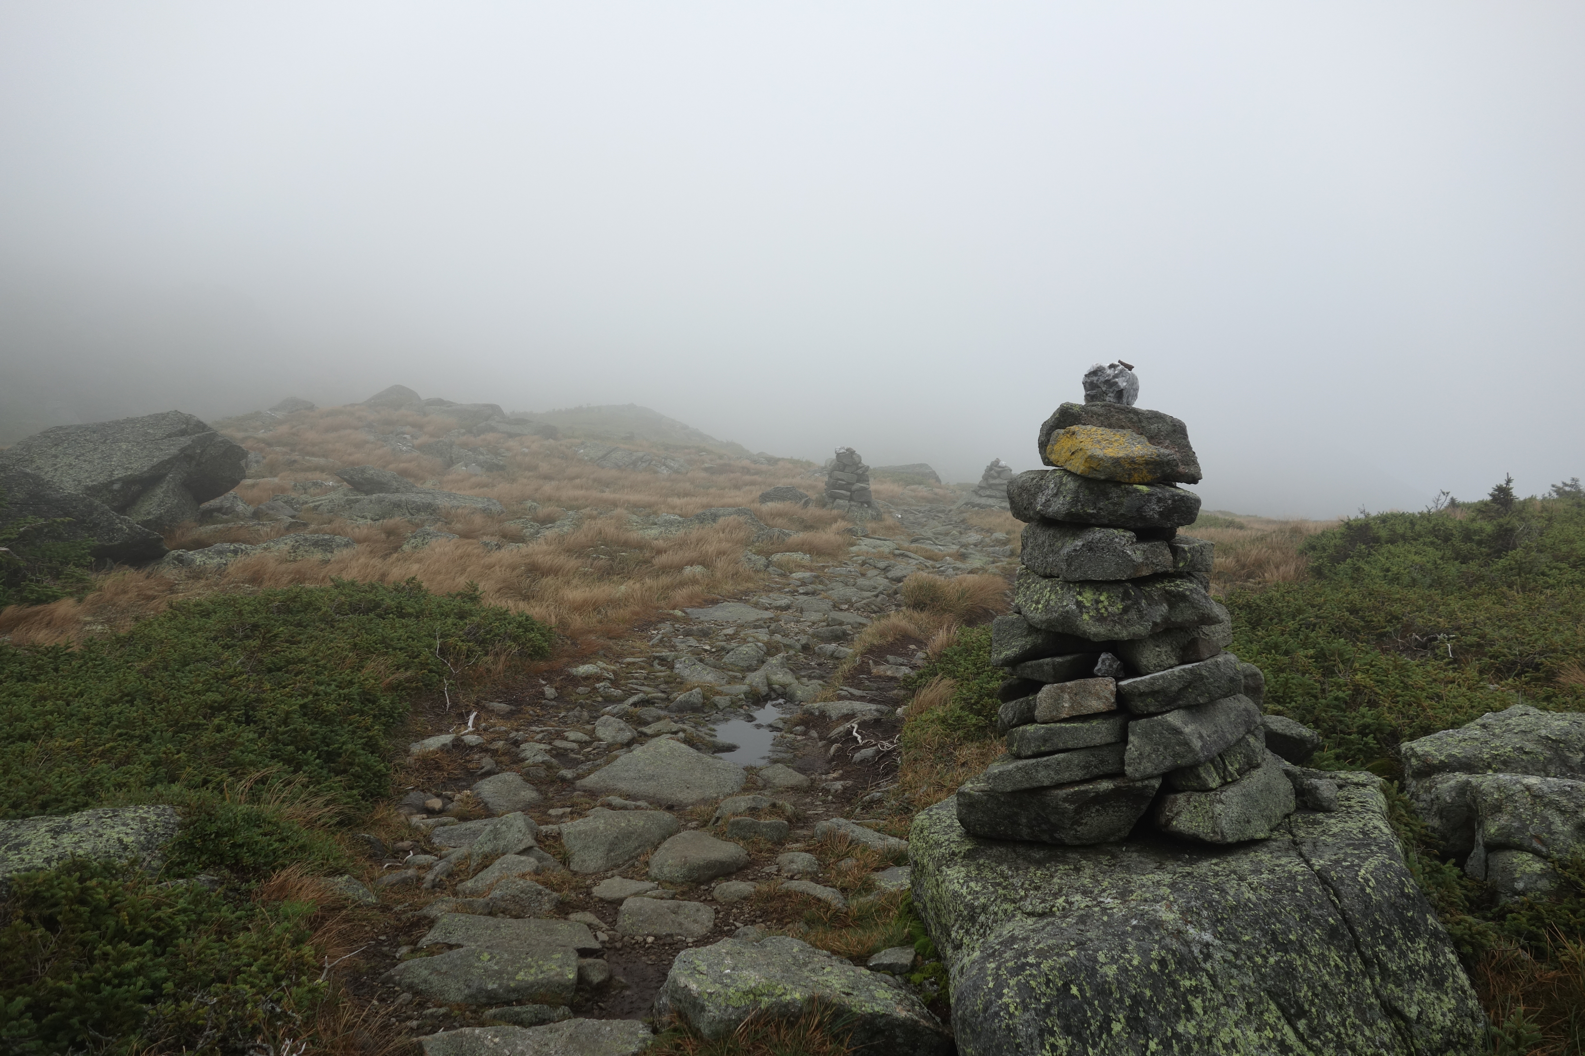
DEMO

Slide 5
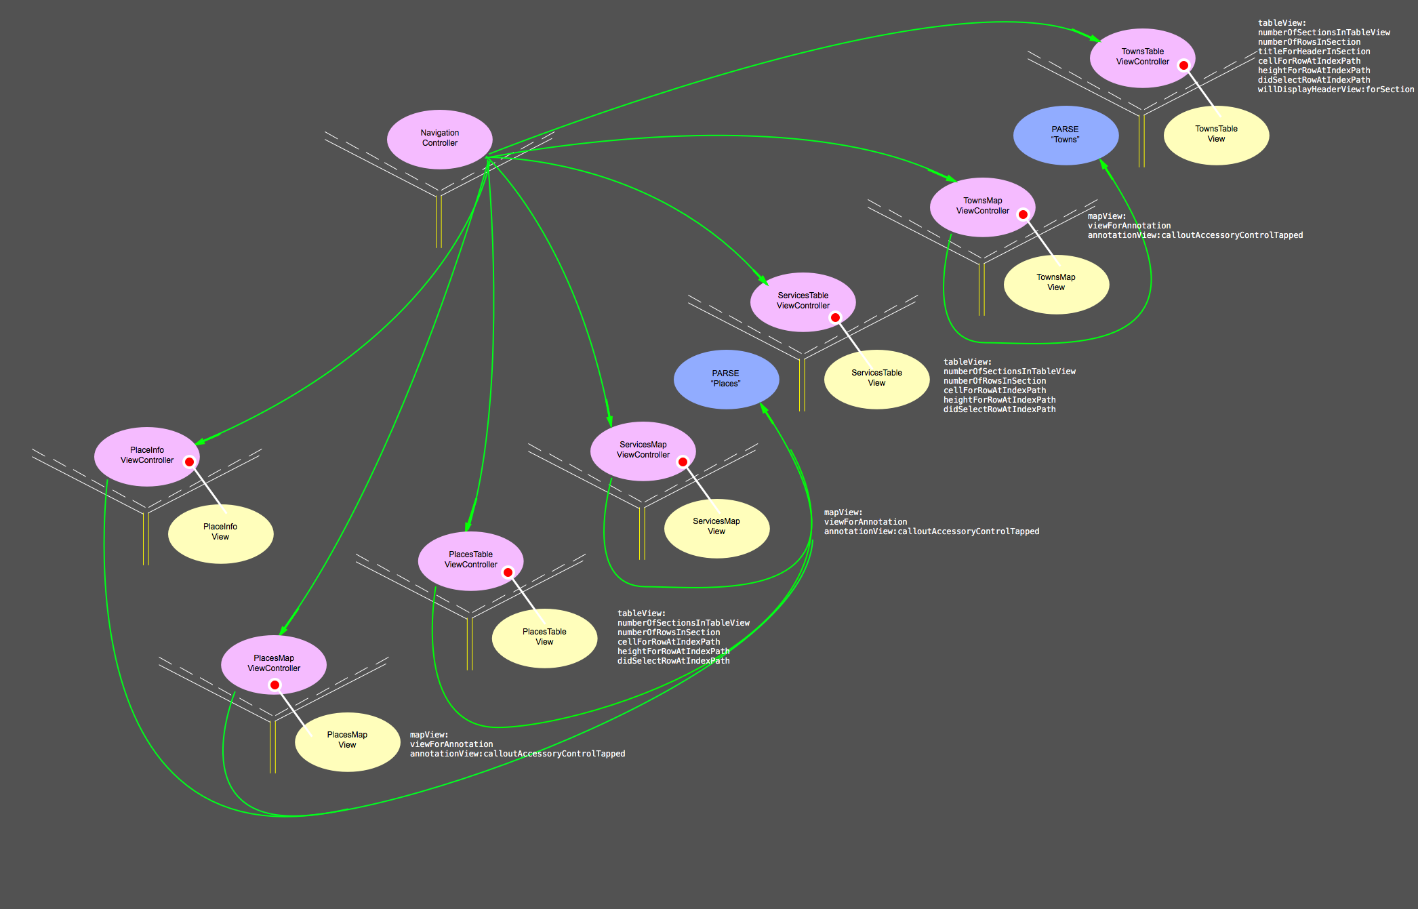

Slide 6
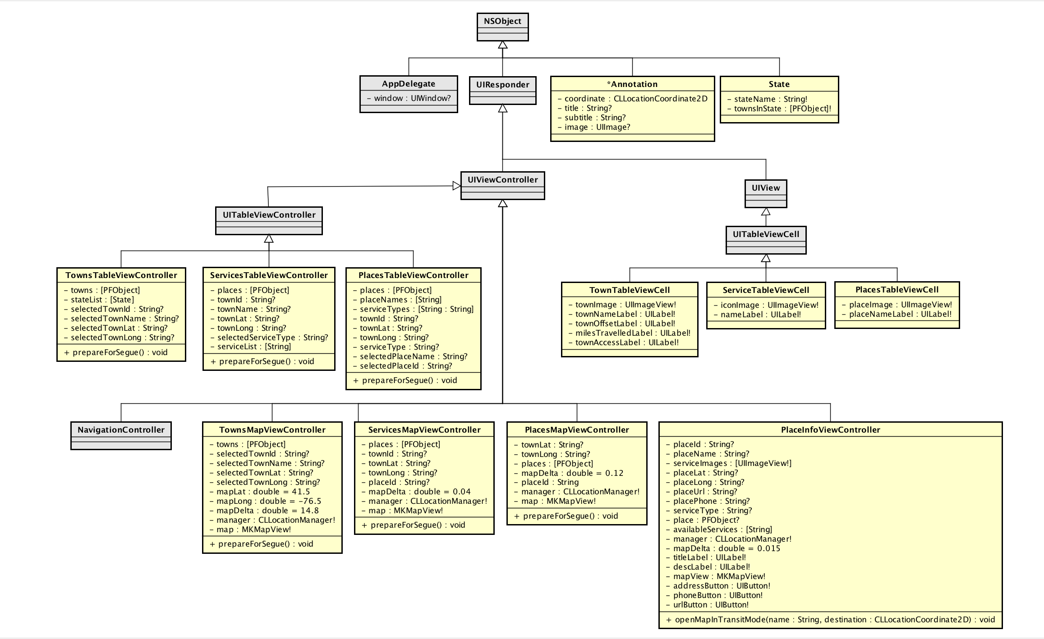

Slide 7
Data Design
PARSE backend
Cloud databases:
Towns containing town names, locations, route and distance from trail, and image.
Places containing similar information AND a pointer to the town to which it belongs.
Users need not download a new version of the app to access the most current data.
Although, user needs to be online (for now).
Queries are made to PARSE to retrieve data as needed based on the current view.
Once a query is made, an array of retrieved PFObjects is stored locally and can be reused.

Slide 8
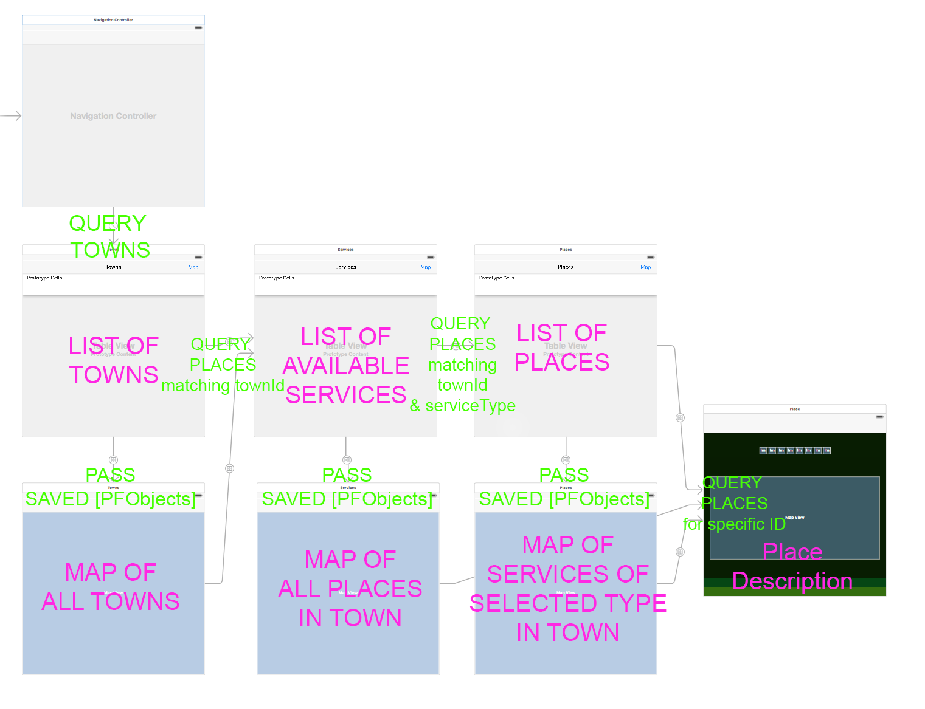

Slide 9
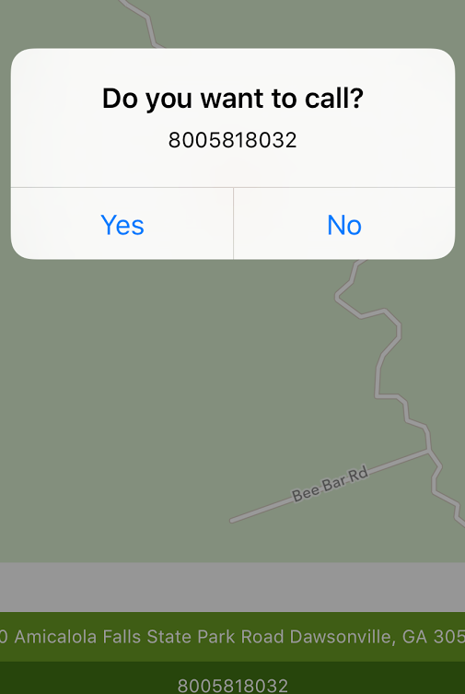
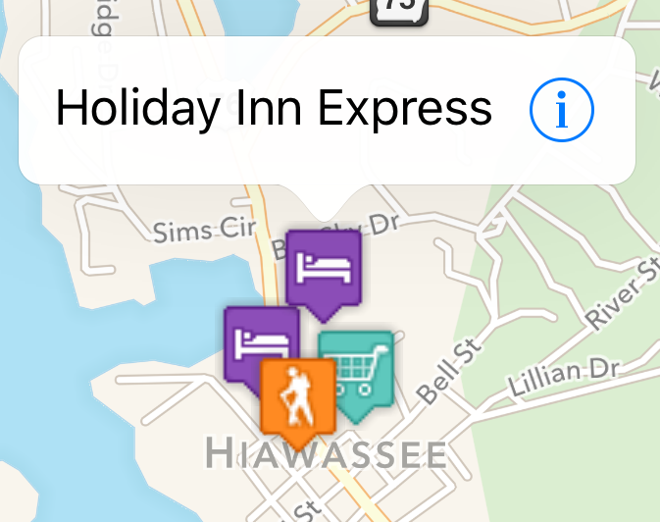
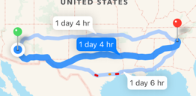
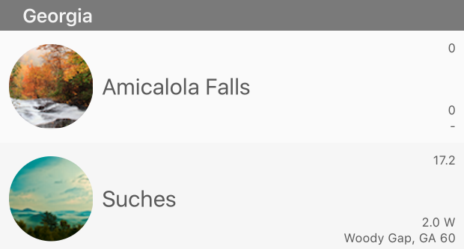
Features / Lessons Learned
UITableview with dynamic number of sections / rows.
Custom TableViewCells
Custom MKAnnotationViews (pins)
Map MKAnnotationView “callouts”
Link to external apps:
Telephone
Maps (in navigation mode – from current user location to selected place)
PARSE Cloud Backend
Mapkit & Location Manager

Slide 10

Work in Progress
PARSE offline storage mode.
Complete the Places database.
Add user reviews and user photos to the each place.
Allow users to add their own photograph.
Improve auto-layout for smaller devices.

Slide 11
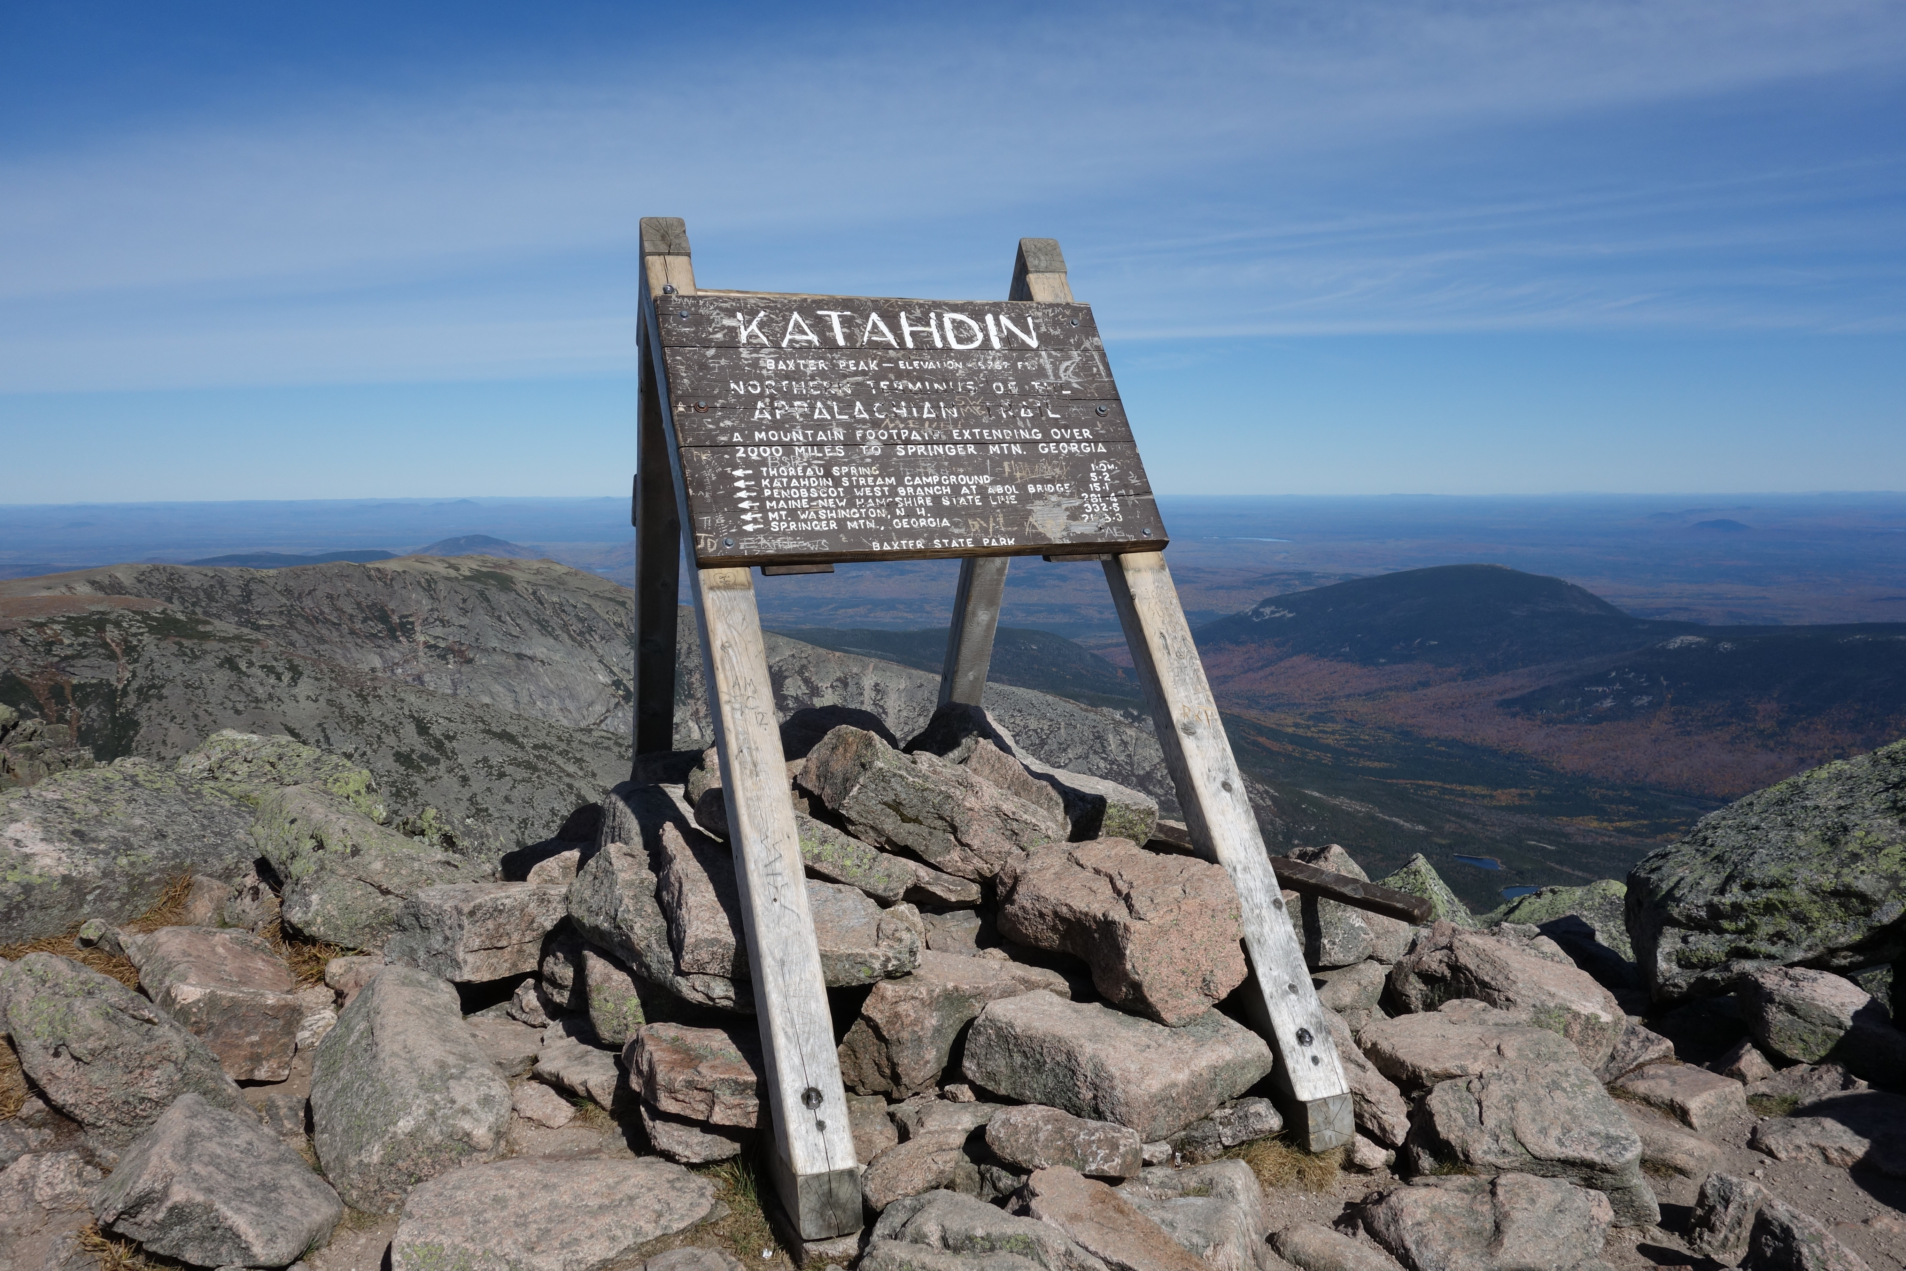
THE END – QUESTIONS?

